Slide 1
Script for: Automated pipeline for conformational analysis and structural alignments
Martin Friis Sørensen | mfs@mbg.au.dk
Aarhus University, Department of Molecular Biology and Genetics
May 7th 2026

Slide 2
Manual pipeline for each protein of interest:
The goal
Find all PDB IDs with x percent sequence identity to a given protein - here integrin alpha subunits
Quickly identify structures containing a beta-propeller
Identify conformation of integrin structures
The problem
Manual pipeline is slow and prone to human error
Difficult to reproduce
The solution
Automated Python pipeline from UniProt ID or raw sequence to a structured Excel report
Copy sequence in UniProt
Search RCSB PDB for PDB IDs with sequence identity
Create tabular report CSV file
Align all PDB IDs in PyMOL
Extract RMSD and angle data

Slide 3
Choose input:
[1] UniProt IDs
[2] FASTA files
[3] Raw sequences
[4] Existing .csv files
[5] Default 18 alpha subunits
Choose alignment method:
[1] Propeller alignment
[2] Angle alignment
[3] Whole structure alignment
[4] Sequence-based homology alignment
if input = 1 or 5
Fetches sequence from UniProt
if input = 2 or 3
Uses sequence to search RCSB PDB for PDB IDs with x% sequence identity
if input = 4
Choose mode:
[1] Headless
[2] Visual
Generates tabular report .csv file for each sequence search:
Entry ID, PubMed ID, Release date, EMDB map, PDB ID, Structure title
Flowchart overview
Checks if .json files exist for chosen method(s) and sequence
if .json does already exist
if a .json does not exist
Outputs all data to an Excel file:
One tab for tabular report and one for results respectively per sequence search
Runs PyMOL commands based on method(s) chosen and .json not existing:
Runs the commands in PyMOL
Saves the data to .json files

Slide 4
Prerequisites to run the script
Run the script within an environment where PyMOL is installed
Internet connection
First install packages:
requests for fetching sequences from UniProt and querying RCSB PDB
pandas for outputting to Excel
openpyxl or xlsxwriter for running pandas
biopython used for pairwise sequence alignments
Paste into PyMOL terminal to install all in the right environment:
pip install requests pandas openpyxl biopython

Slide 5
Test of script with
ITAM_HUMAN
ITAX_HUMAN
Show how the visualization will look
Time on my computer to run all 18 alpha subunits:
Input to output Excel file: 10 minutes
Running .pml file in PyMOL: 6 minutes

Slide 6
Future improvements
Allow for one line interface
Integrin beta subunit hybrid domain alignments
Ability to align for any UniProt entry with a given identity
Smaller improvements:
Add comments to script
Distribute code to smaller files instead of one large
Automate testing that everything keeps working
Use Pixi instead of Conda for faster/easier installation of packages

Slide 7
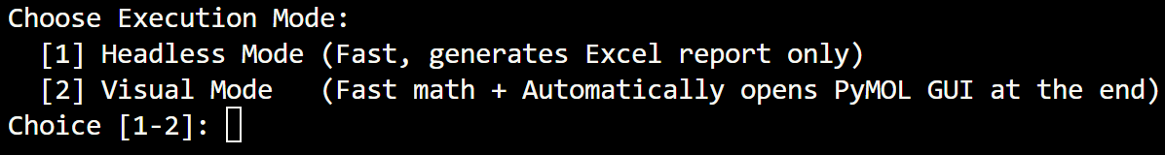
Choose between:
1: Running PyMOL in the background (headless) and creating Excel output
2: Open PyMOL GUI at the end for visualization of alignments (saves script)
Choose mode:
[1] Headless
[2] Visual
In terminal:

Slide 8
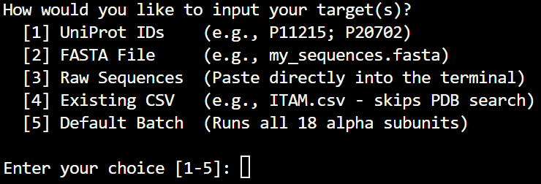
When the script is run in the terminal it prompts you to type 1-5 how you want to input target:
1: Type in one or more UniProt IDs separated by semicolon
2: Allows for loading a FASTA file in the folder
3: Allows for pasting amino acid sequence(s)
4: Use previously made .csv from RCSB PDB tabular report
5: Uses dictionary of UniProt IDs for all 18 alpha subunits
Choose input:
[1] UniProt IDs
[2] FASTA files
[3] Raw sequences
[4] Existing .csv files
[5] Default 18 alpha subunits
In terminal:

Slide 9
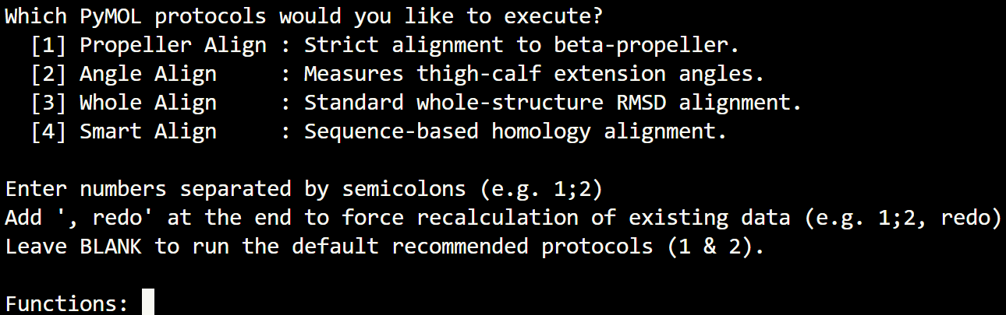
You will be prompted to type 1-4 (or multiple separated by semicolon) which method(s) to run:
1: Alignment to beta-propeller
2: Measuring angle between thigh and calf
3: Whole structural alignment
4: Uses sequence alignment to find the best alignment
+ Add “, redo” to recalculate existing data
Choose alignment method:
[1] Propeller alignment
[2] Angle alignment
[3] Whole structure alignment
[4] Sequence-based homology alignment
In terminal:

Slide 10
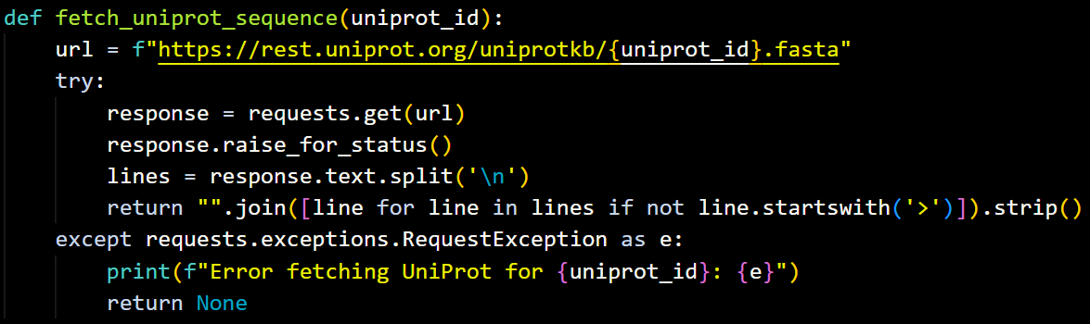
Function:
Takes UniProt ID as input
Requests FASTA sequence from UniProt
Returns the amino acid sequence
Fetches sequence from UniProt

Slide 11
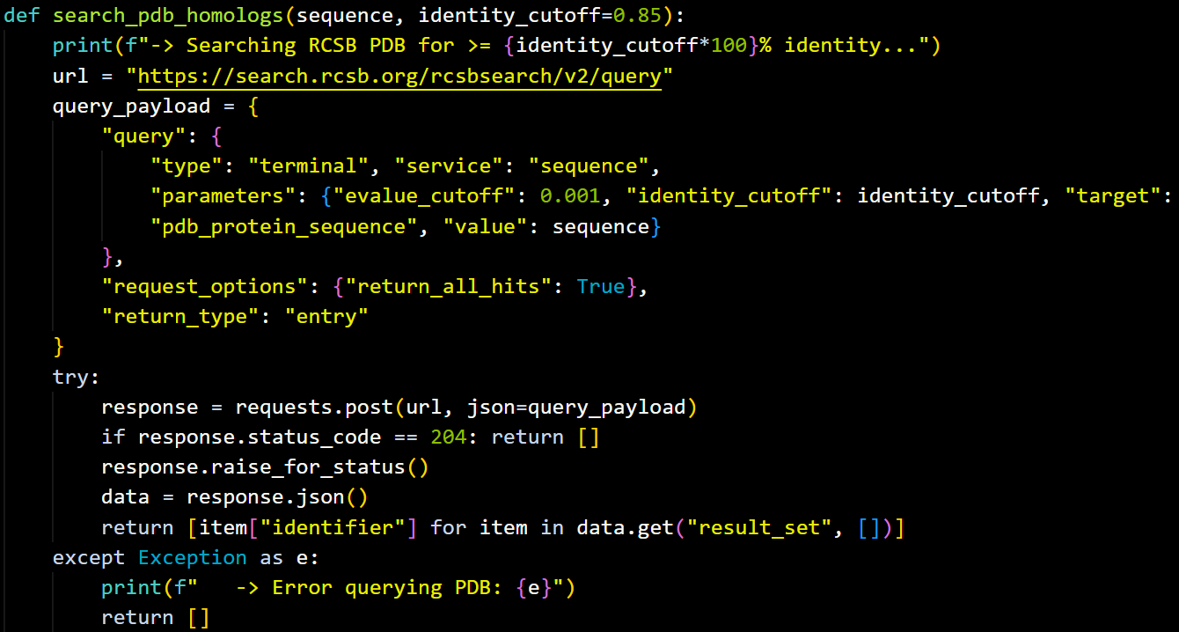
Function:
Takes amino acid sequence as input
Asks RCSB PDB to return all PDB IDs with or above the given percent sequence identity
Uses sequence to search RCSB PDB for PDB IDs with x% sequence identity

Slide 12
Function:
Takes list of PDB IDs and CSV filename
Fetches metadata (Entry ID, PubMed ID, release date, EMDB map, PDB ID and structure title) from RCSB PDB
Outputs CSV file with results from RCSB PDB like a tabular report
Generates tabular report .csv file for each sequence search:
Entry ID, PubMed ID, Release date, EMDB map, PDB ID, Structure title

Slide 13
Function:
If “redo” is used this will be skipped
Checks if JSON files exist for the given PyMOL commands and sequences before running the commands
If a given file exist: PyMOL command is skipped
If a given file doesn’t exist: run PyMOL command
Checks if .json files exist for chosen method(s) and sequence

Slide 14
Function:
Takes CSV files as input
Runs the chosen custom PyMOL command(s):
Align using alpha subunit propeller
Align alpha subunit thigh and calf-2 to measure angle
Align whole structure
Use pairwise sequence alignment to find best alignment
Saves RMSD, number of atoms aligned and angle data to JSON files per input sequence, percent identity and command
Runs PyMOL commands based on method(s) chosen and .json not existing:
Runs the commands in PyMOL
Saves the data to .json files

Slide 15
Function:
Takes dictionary of the input sequence(s)
Reads relevant CSV and JSON files
Creates Excel document with two tabs for each input sequence: tabular report metadata and results
Outputs all data to an Excel file:
One tab for tabular report and one for results respectively per sequence search

